Slide 1
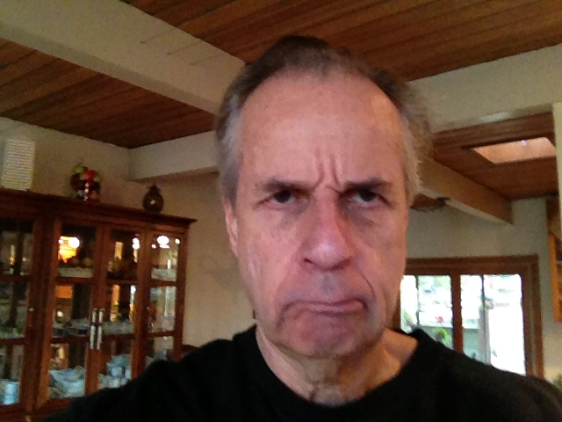
Towards professionalism in forensic mathematics
Charles H. Brenner, Ph.D.
forensic mathematician
licensed curmudgeon
Charles H. Brenner, Ph.D.
forensic mathematics / licensed curmudgeon
DNA·VIEW
Visiting Scholar, School of Public Health, UC Berkeley
http://dna-view.com
Notes:
I am going to discuss concerns I have about the practice of forensic mathematics – a practice that is mentally careless in many cases -- and the negative impact that I think this carelessness has on giving evidence in court, and on advancing forensic mathematical theory. Since it’s going to be a bad-natured talk I’ll illustrate by beginning with a joke borrowed from James Curran.

Slide 2
Outline of presentation
Mathematics has an important role in DNA analysis
Doing it randomly vs. doing it right
  Right: State the problem, postulate a model, etc.
    Permits understanding and evaluation
  There are lots of published contrary examples

Slide 3
Forensic mathematics
Mathematics of evidence
  DNA evidence
    Goals: Identification / connect suspect to crime
    Some examples discussed/debated in literature
      Simple & mixed stains
      Rare haplotype evidence
      Database search
Mathematics applies to the world via models
mathematical world
real

Slide 4
Houses
w
h
Mathematical
Real
A=wh
A≈wh
All models are wrong, but some models are useful.
G.E.Box

Slide 5
Some models
Mendelian genetics
  Random mating, no mutation, no migration
  Implies Pr(PQ genotype)=2Pr(P)Pr(Q)
Mixture models
  “exclusion” models (suspect profile ignored except as included or not)
  PCR models. Example approaches:
    Just a rule: Peak height ratio > some value
    Mechanism: Model stochastics of degradation and amplification.
What do these models have in common?
  All of them are wrong – though maybe useful.

Slide 6
(forensic) mathematical exposition
Features / paradigm
Benefits
State problem
Formulate it mathematically
State premises
  What is the model?
Justify the premises
  Validate the model.
    Test=innocent suspect
Derive the result
Explain accurately
Logical; persuasive
  Linear deductive organization
Facilitate discussion/argument
  Where do we disagree?
    Premises? Reasoning step?
  Resolution
Notes:
The linear deductive organization justifies the claims or recommended method.
These ideas not alien in the statistical world. Stating model is routine for trained statisticians, though validation mixed.
Thus in Cowell “gamma” I can find the problem, the model, derivation of formulas, some nod towards validation.

Slide 7
offending expository styles
Features / paradigm
“Benefits”
Omit statement of problem.
Omit premises.
  Do not describe any model.
Recipes, not logical reasons
Sophisticated exposition
  “An attractive point of view …”
  Unsupported opinions
  “It is convenient to assume a β distribution.”
Easier than thinking
  Example: SWGDAM on rare haplotypes
With nothing written down, nothing wrong is written down and errors are less obvious.
Entertaining
  Say nothing → offend no one
  Writer=authority. Reader=student.
  Convenience of statisticians is important, not criminal justice.
Notes:
Unsupported opinions – giving logical justification reduces my authority and importance

Slide 8
The mythical “exclusion” method for DNA mixtures
Original method: If suspect “included”, calculate RMNE per locus as (p+q+r+...)² where p, q ... are the allele frequencies of alleles observed above threshold – e.g. above 100rfu.
  No detailed explanation, but we can reverse-engineer this simple formula and realize that the model is:
    All alleles of a donor will be visible at >100rfu (!)
    “Included” means all alleles visible at >100rfu (!)
  Ridiculous, but survived many years because with nothing written down, nothing wrong is written down and errors are less obvious.
New revised method still just a recipe.
  Probably mostly wrong. Certainly unjustified.

Slide 9
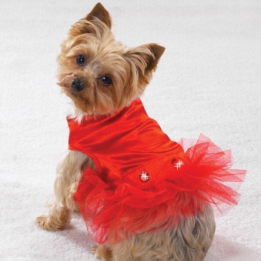
Confidence intervals
Fine in their place – elsewhere
Adorning a (matching) probability with a confidence interval is like putting clothes on a dog.
  Matching probability ≠ population frequency!
What argument do my adversaries give?
  “You must do something. This is something.”
  “Leave me alone.”

Slide 10
Rare haplotype matching probability
Features / paradigm
Brenner paper (FSIgen 2010(4))
State problem
Formulate it mathematically dummy line
State premises
  What is the model?
Justify the premises
  Validate the model.
    Test=innocent suspect
Derive the result
Evidential value of match?
Pr(innocent suspect matches | crime scene, database)
Type is (mostly) just a name
  “equal over-representation”
Validation by tediously simulating/examining suitable range of populations
LR=n/(1-κ) (for new type)
  n=reference database size
  κ=singleton proportion
Notes:
The linear deductive organization justifies the claims or recommended method.

Slide 11

Validation claims in a sophisticated paper (Buckleton, Krawczak, Weir – FSIgen 2011 )
Brenner “potentially anti-conservative” re evidential value of a rare haplotype match – (FSIgen 2010(4)281-291 paper)
Notes:
resting largely on unsupported opinion (“we believe”, “it is
difficult to perceive”), factual errors, incompetent mathematics and logic, and apparently scientific misbehaviour

Slide 12
Validation claims in a sophisticated paper (Buckleton, Krawczak, Weir – FSIgen 2011 )
?
Brenner “potentially anti-conservative”
  Meaning: Their analytical attempt hit dead-end; failed to prove my method either right or wrong.
  Better approach: Read and judge my paper’s validation section.
Frequency surveying method “recently validated”
  Not according to the cited paper, or testimony of an author (per Anderson).
  False claim requested by referee (per Weir).
    Defense attorney might infer the behavior shows lack of professionalism in forensic statistical publication generally.
Notes:
resting largely on unsupported opinion (“we believe”, “it is
difficult to perceive”), factual errors, incompetent mathematics and logic, and apparently scientific misbehaviour

Slide 13
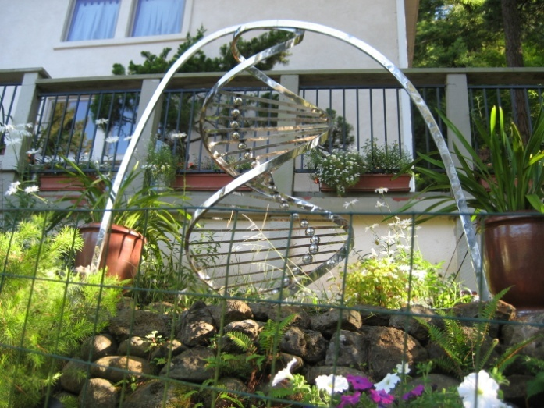
Conclusion – forensic mathematical standard
Coherent logical exposition from start to finish.
  Problem? Model & premises? Logic? Validation?
  It’s not our job to find the errors, but the authors’ to prove the case.
Current practice is overall very shabby.
Good practice permits elevated discourse.
Take home –
  Everything is models.
  If nothing is written down, then nothing wrong is written down and errors are less obvious.
  The test is the innocent suspect!
Thematic garden sculpture
Notes:
For validation try to concentrate on that often over-looked because it is the rarest of species, the innocent suspect.

Slide 14
